Slide 1
CONTROL SYSTEM DESIGN AND ANALYSIS
SYSTEM TRANSFER FUNCTION AND RESPONSE

Slide 2
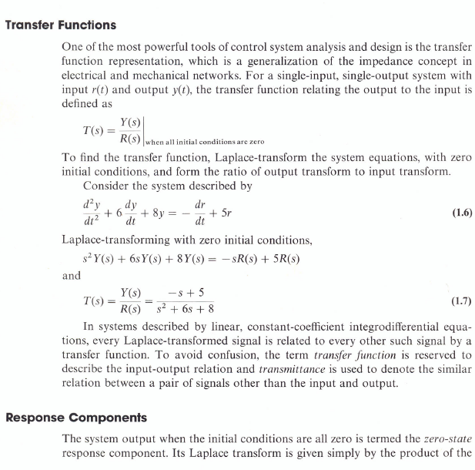
Transfer function

Slide 3
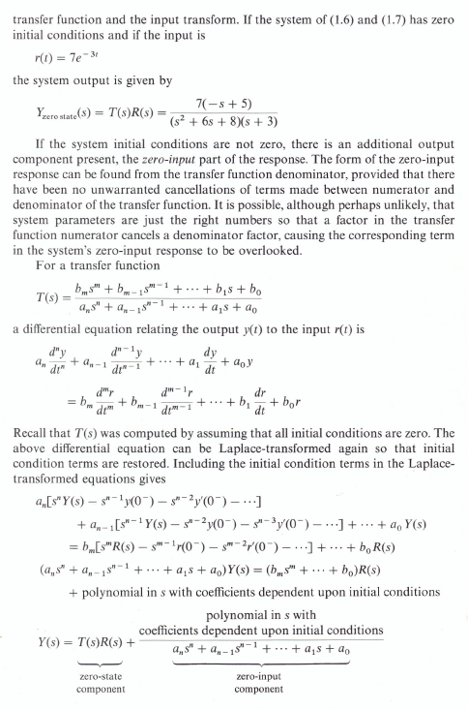

Slide 4
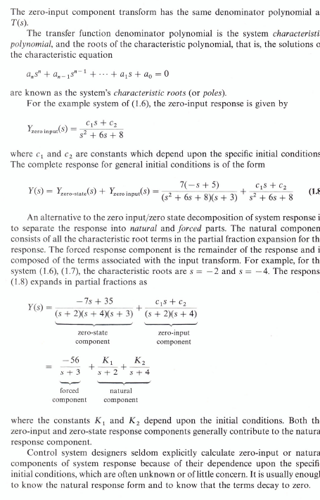

Slide 5
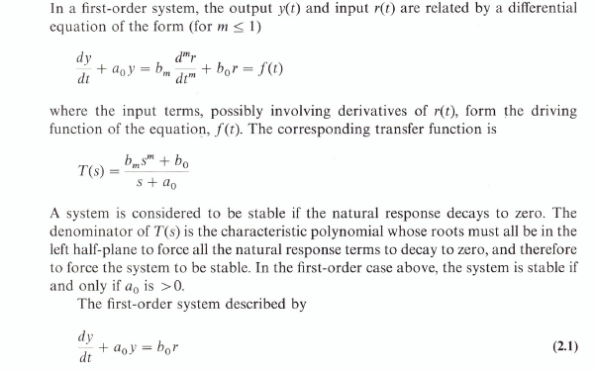
Response of first order systems

Slide 6
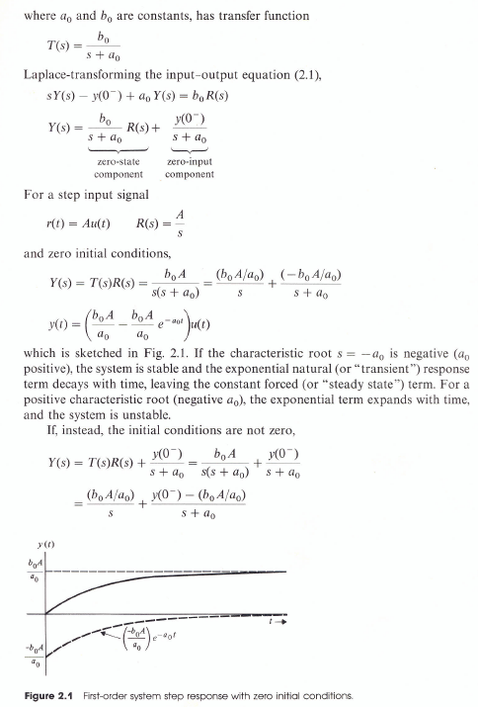
Response of first order systems-cont

Slide 7
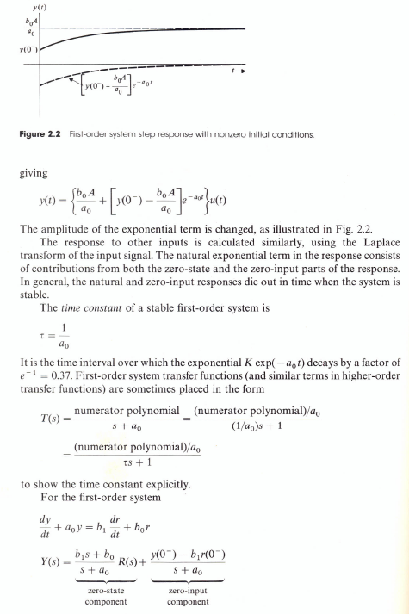
Response of first order systems - cont

Slide 8
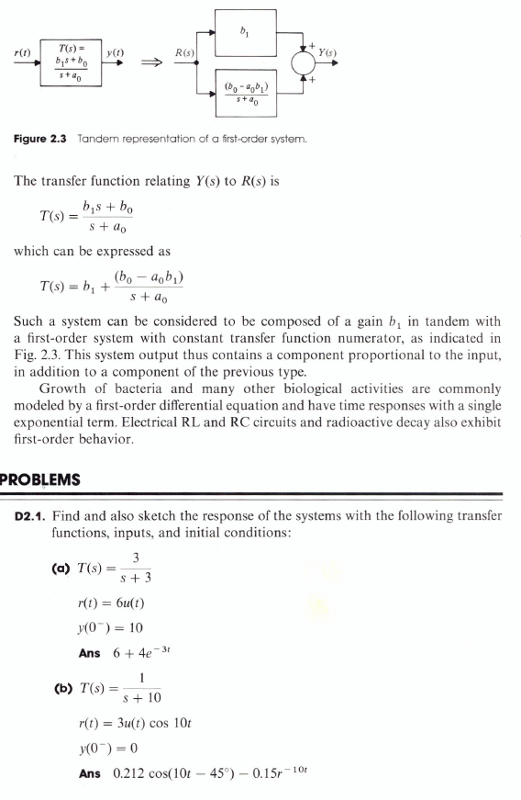
Response of first order systems - cont

Slide 9
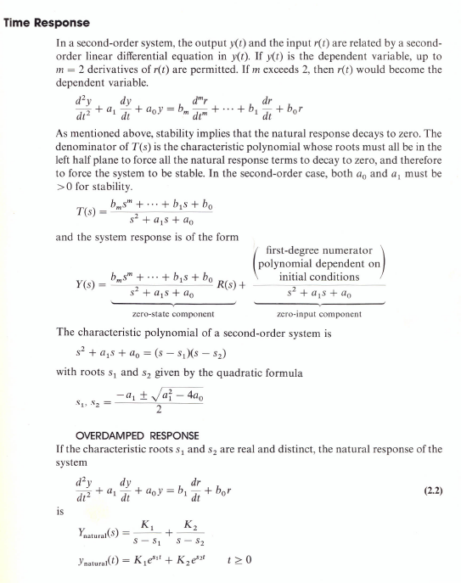
Response of second-order systems

Slide 10
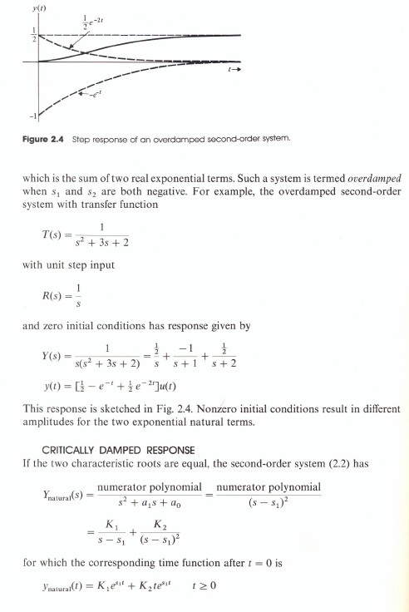
Response of second-order systems-con

Slide 11
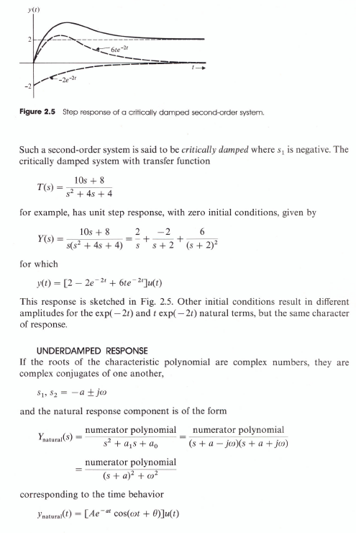
Response of second-order systems-cont

Slide 12
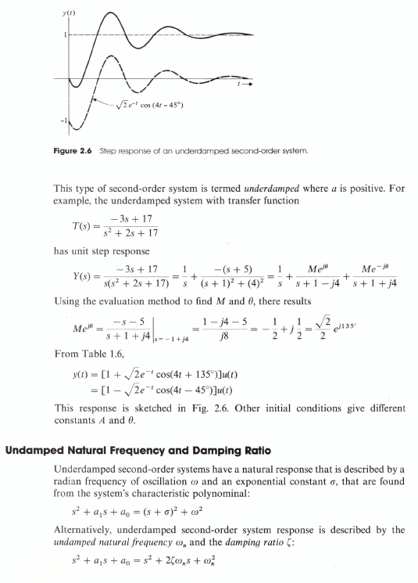
Response of second-order systems-cont

Slide 13
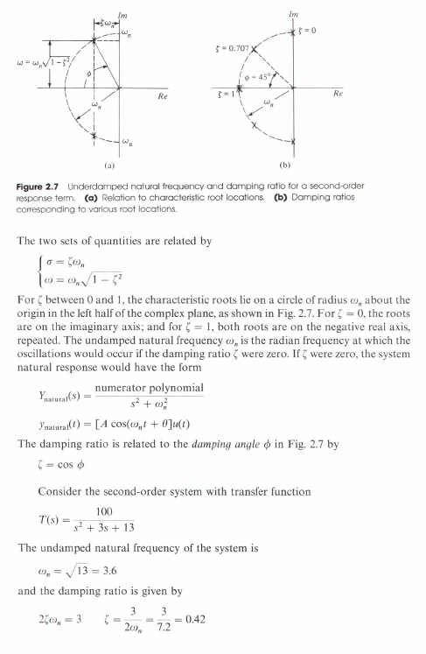
Response of second-order systems-cont

Slide 14
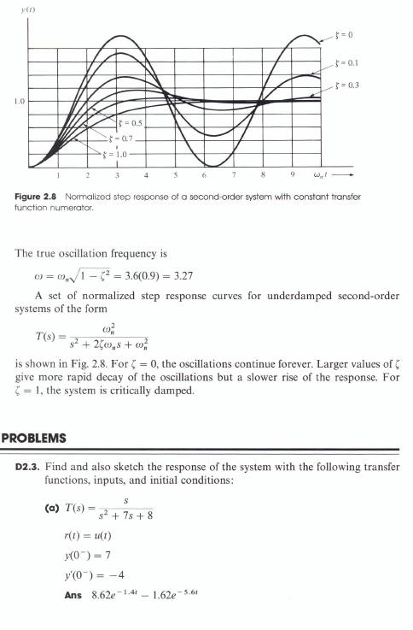
Response of second-order systems-cont

Slide 15
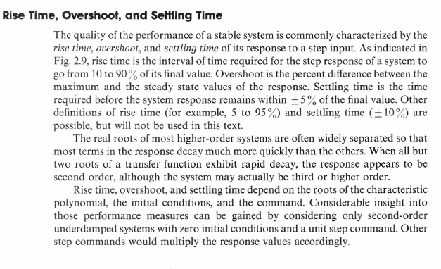
Design specifications

Slide 16
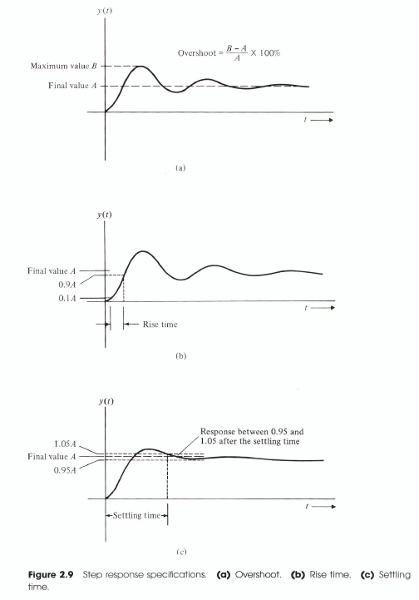
Design specs - cont

Slide 17
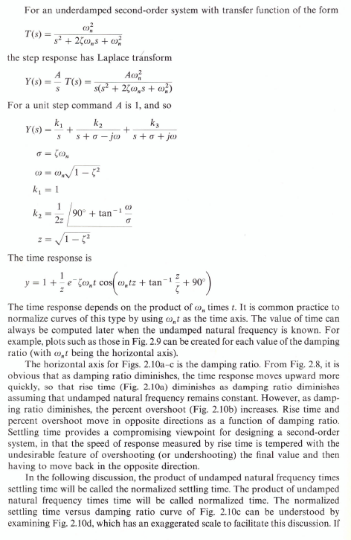
Design specs - cont

Slide 18
Design specs - cont

Slide 19
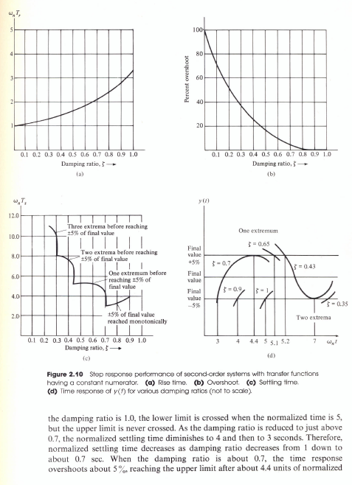
Design specs - cont

Slide 20
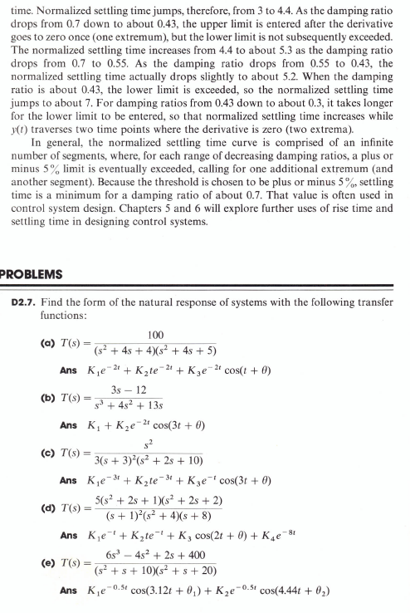
Design specs - cont

